Slide 1
School District 78 Trades, Apprenticeships & Certificate Opportunities

Slide 2
Do you know what you want to be when you grow up?
THINK FAST!

Slide 3
Do you plan to attend post secondary school?
(Any education pursued beyond high school)

Slide 4
Not Going to Post Secondary?
Would you go if SD78 could pay your first year’s tuition?
Already going and want to hear about FREE TUITION?
(Keep listening)

Slide 5
Why can I get Free Tuition?
We don’t have the capacity to offer all educational programs in High School.
SD78 has agreements with specific institutions, to offer Dual Credit programs, opening the door to programs we can’t offer in the high school.

Slide 6
What is Dual Credit?
“Students are enrolled in High school and Post Secondary at the same time.”
“Students only attend Post Secondary, but earn credits for high school and post secondary at the same time.”
The ministry is paying for the student to attend high school, which pays for the post secondary tuition.

Slide 7
Dual Credit Programs are not a free ride, but with a couple scholarships they could be!
Example
Professional Cook Foundation Program at UFV
(level 1 & 2)
Tuition paid by SD78 $4,591.86
Ancillary Fee $550.68
Student Fee $310.40
Tools (you keep) $450.00
Books (you Keep) $642.00
Clothes (you keep) $200.00
Total $6,960.53
Your cost $2,368.67
(Your Educational Costs $861.08)

Slide 8
SD78 Dual Credit programs include Trades Programs and Certificate Programs
(We have reserved and preferred seating.
Jump the waitlist!)

Slide 9
What is a Trade?
“Arts & Crafts for Adults”
Typically hands on jobs requiring manual skills

Slide 10
Can you name a Trade?
Common Examples of Trades
Cooks & Bakers
Construction workers
Electricians
Hair Stylists
Mechanics
Plumbers
Welders …

Slide 11
Find a full list of Trades through the ITA “Industry Training Authority”
100+ Trades Programs Exist in BC!
49 of which are Red Seal
www.itabc.ca

Slide 12
Trades Qualifications (Tickets) are earned through Apprenticeships
What is an Apprenticeship?
A combination of on-the-job training and classroom learning that leads to a trade credential – or “ticket”

Slide 13
Traditional Apprenticeship Route
1. Find a job / employer sponsor
2. Accumulate Hours / Experience
REPEAT
3. Attend school for 6-10 weeks.
(collect EI while attending school)

Slide 14
Trades Foundation Program Route
(No Sponsor Needed)
Attend School 24-42 weeks (depends on program)
Learn the theory in the classroom
Get hands on experience in a shop setting (Gain hours)
Graduate with Level 1 (maybe 1 &2)
Find work quicker with training and experience, expect better pay

Slide 15
SD78 Trades Foundation Dual Credit Programs
Aircraft Structures
Automotive Auto Collision & Repair Architectural Drafting
Carpentry
Electrical
Electronics
Heavy Mechanical
Joinery Plumbing
Professional Cook
Welder Foundation
*This is just a partial list

Slide 16
Trades are Dirty, Hard, Manual Labour Jobs that don’t pay
Hard workers, trained workers and smart workers move up the ladder and pay scale quickly, especially with the current demand for trades people.
Become a Foreman,
owner,
contractor,
instructor,
inspector, ...

Slide 17
What is a Certificate Program?
“1 year academic program offering up to 30 credits”
Some certificates lead to immediate employability
Apply certificate courses to further education.
Explore and earn credit in a field before committing to a specialty

Slide 18
Interested in a Diploma or Bachelors Degree?
Many certificate programs offer the same courses used in Diploma and Bachelor programs.
Bachelor = 120 credits -up to 30 credits
Diploma = 60 credits –up to 30 credits
Transfer credits to another Post Secondary Institution
UFV $145 per credit = $4,350
*Use the bctransferguide.com to check where your credits transfer

Slide 19
SD78 Dual Credit Certificate Programs *Secured & in the Works
Community Support Worker Certificate *
Health & Human Services Certificate *
Hospitality Event Planning Certificate *
Early Childhood Education Certificate
Accounting certificate
Criminology certificate
Engineering certificate
Foundations in Design certificate
General Business Studies certificate
Health Care Assistant certificate
Legal Administrative Studies certificate

Slide 20
Do I have to stick with a Trade or Certificate for my career?
No
Use it as a back up plan (be done with entry level jobs)
Get a better paying job to pay for that diploma or bachelors

Slide 21
Post Secondary Institutions offering these programs

Slide 22
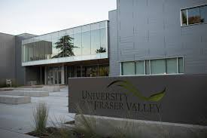
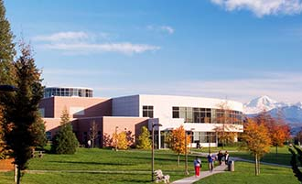
UFV - University of The Fraser Valley
Chilliwack Trades Campus
Abbotsford Campus

Slide 23
BCIT - British Columbia Institute of Technology
Burnaby

Slide 24
TRU - Thompson Rivers University
Kamloops

Slide 25
KPU - Kwantlen Polytechnic University
Cloverdale Surrey Langley Richmond

Slide 26
Northern Lights College
Fort St. John Dawson Creek

Slide 27
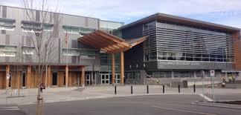
Chilliwack Senior
Hair Dressing Program

Slide 28
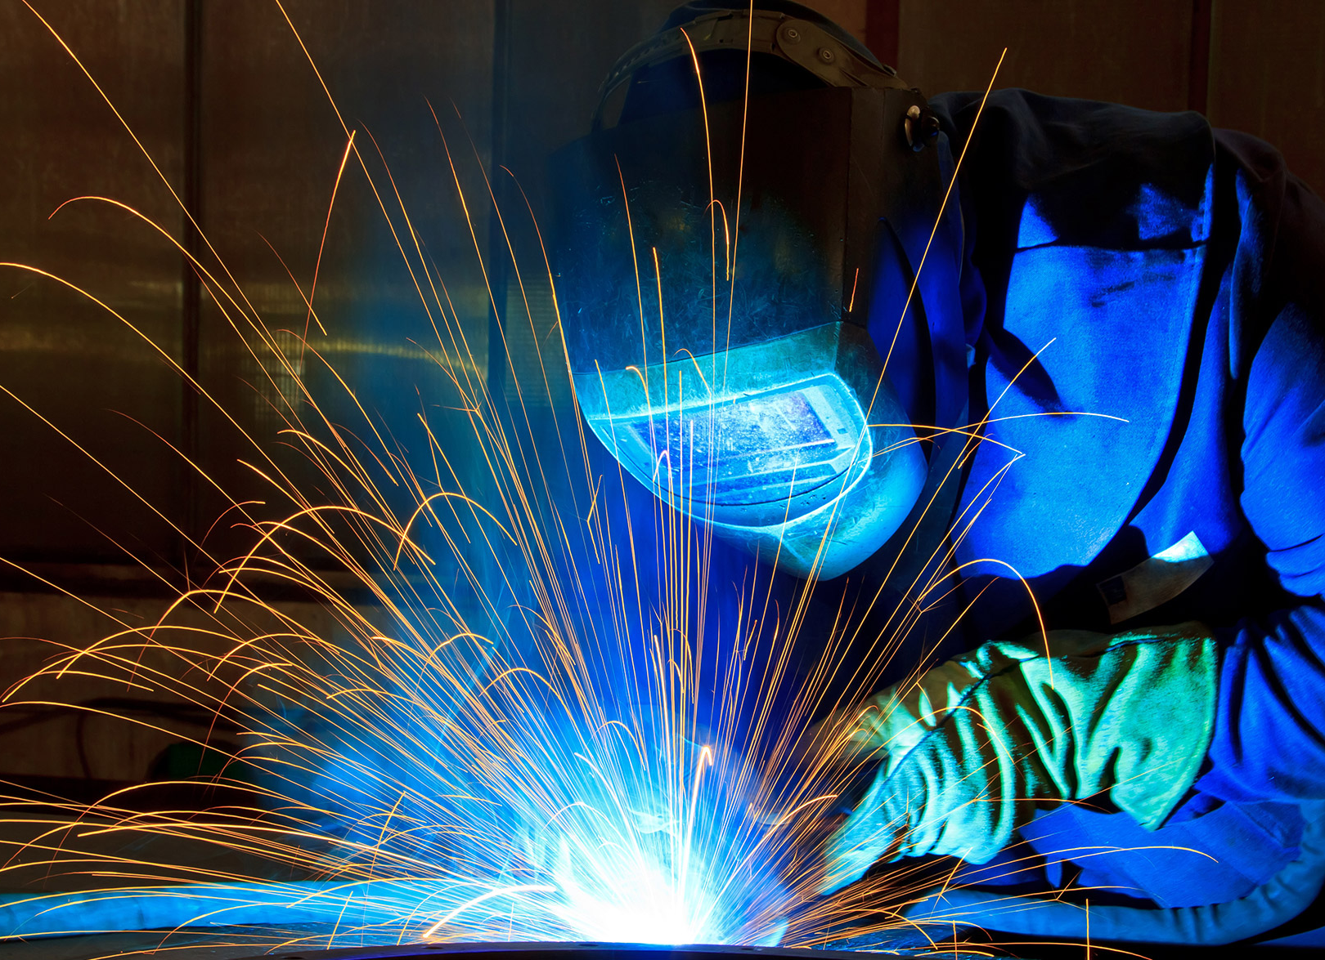
TRU Welding Program at HSS
A 26 Week program granting students their level 1 & 2 welding tickets
Starts mid-summer and finishes with semester 1
The classroom is a 53 ft. trailer that expands into a 1,000 sq ft. training facility, housing 12 welding stations.

Slide 29
What do I need to get into these programs?
Meet university entrance requirements
Minimum 60% in math 10/11 and Com/Eng 12
Seats are limited, preference will be given to students with:
Good Attendance
Related elective courses
Youth Work in Trades courses
Work Experience courses

Slide 30
Other Opportunities with SD78 to Explore Careers

Slide 31
Heavy Metal Rocks
Explore the career choices of heavy equipment operators in the construction industry.
hands on experience on many types of heavy equipment, with experienced operators
Leave with Certificates:
Construction Safety / First Aid / WHMIS Training

Slide 32
Northern Opportunities Tour
Climb a wind turbine
Tour Ft. St. John and Dawson Creek Northern Lights College
Walk around a oil & gas drilling derrik
Learn about the BC Hydro Site C dam
Tour Tervita, Shell, Progress Energy, and/or Encana facilities.
Get a taste of what life at camp is really like.
Learn about the lives and careers of men and women working in the energy sector, while playing a round of golf.

Slide 33
Work Experience
WEX 12A & WEX 12B are 2 grade 12 elective classes allowing students to get credit for working.

Slide 34
Youth Work in Trades
Are you already working in an Trade?
Earn up to 4 elective courses for your work & a $1,000 Scholarship

Slide 35
$1,000 Scholarship
Completed the 4 Youth Work in Trades courses
Complete 900 Apprenticeship hours (22.5 full time weeks) before Aug 31st of the school year you turn 19
C+ average in your grade 12 courses

Slide 36
Space is limited in these programs and opportunities, Let’s Chat Early
Student’s, see me during a flex block
Parents, I’d be happy to set up a meeting with you and your son or daughter to chat about career programs offered by SD78

Slide 37
Thank you

